Slide 1

Introduction
to
Computer Science
CS101.3
Lecture #13
Pramudya Thilakaratne pramudya.h@nsbm.ac.lk
Lecturer
Faculty of Computing
NSBM Green University

Slide 2
Welcome to Lecture 13!
Take your notebooks and prepare
You can ask questions via either chat message or over the mic.
When you are not using the mic please mute it.

Slide 3

From Last Week
Computer Storage Structure
Computer Networks
Internet

Slide 4
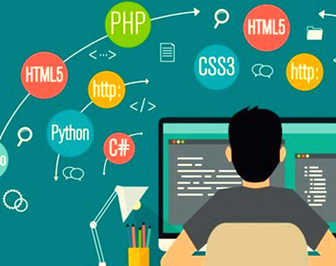
Web Based Production Techniques

Slide 5
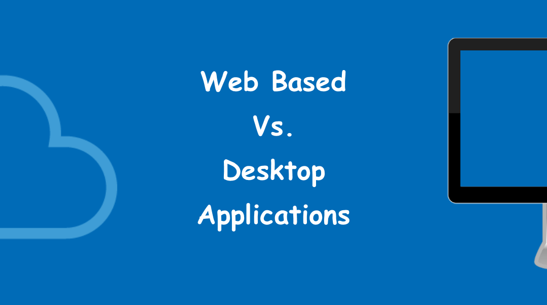
Types of Computer Applications
When considering about computer applications it can categorized into two main sections
01. Standalone Applications (Desktop Applications)
02. Web Based Applications

Slide 6
Why Web Technology is So Popular
Readily available in anywhere anytime and no prior installation required
More people have access to websites due to evolution of internet technology and evolution of digital devices
Easy to develop and easy to maintain

Slide 7
What is a Website
A Website is a collection of web pages and related content that is identified by a common domain name and published on at least one web server
Web page can be created by using HTML, CSS and JavaScript etc.
Every page is a single HTML document, and all of them are connected through hyperlinks (or simply link) which can be combined in a navigation bar for ease of use.

Slide 8
What is a Website
The navigation bar is displayed on every page rather than just the homepage.
It allows the user to quickly move across the main website’s structure.

Slide 9
Navigation Bar

Slide 10
What is a Website
Another important section of most websites is the footer, which is another recurring section that is found at the bottom of every page.
Usually the footer contains external links pointing to similar websites and other external resources, together with other vital info such as disclaimers, links to the terms of service, privacy policy and contact pages, as well as the physical address of the company that owns the site.

Slide 11
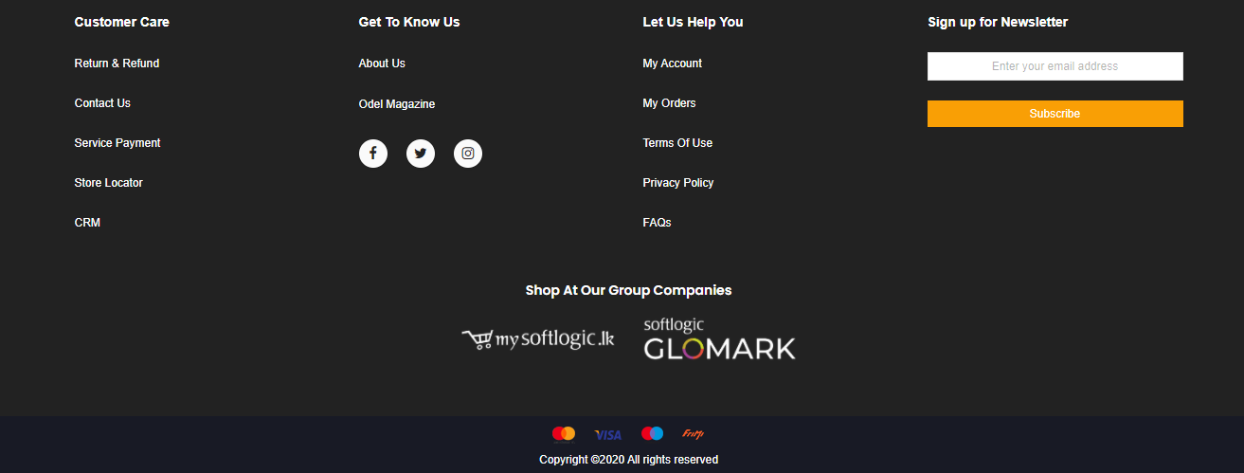
Footer

Slide 12
What is a Website
Websites are hosted on servers, and require a web browser such as Chrome, Firefox or MS Edge to be visited by using computer or mobile device.
A website can be accessed directly by entering its URL address or by searching it on a search engine such as Google or Yahoo search
Originally, websites were categorized by their top-level domains

Slide 13
What is a Website
Government agency websites - .gov
Educational institutions websites - .edu
Nonprofit organizations websites - .org
Commercial websites - .com
Information sites - .info

Slide 14
What is a Website
In modern days internet , the .com extension is by far the most popular domain, together with many other country-specific extensions (.lk, .uk, .fr etc)

Slide 15
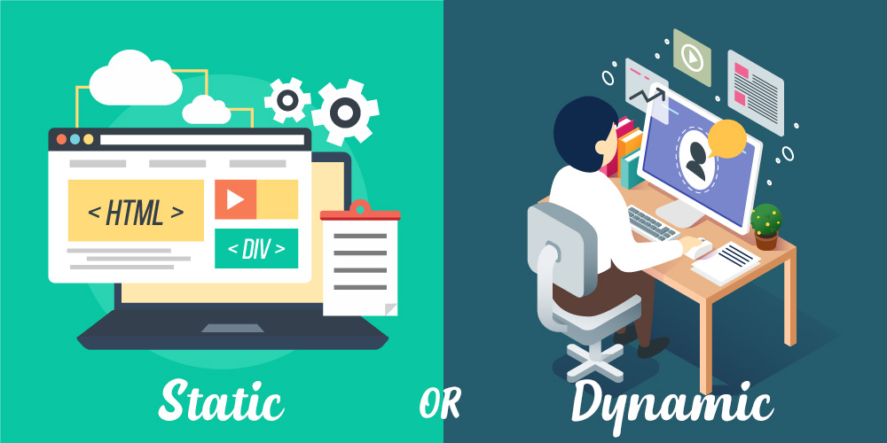
Types of websites
When considering about websites, it can categorize into two main sections
Static Websites
Dynamic Websites

Slide 16
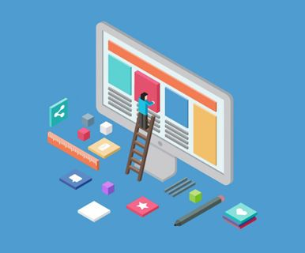
01. Static Websites
Static websites is using pure HTML without relying on the content, or parts of the content being pulled from various databases.
This means each page is constructed on its own coded and loaded individually, no matter who or how the visitor arrives on the page.

Slide 17
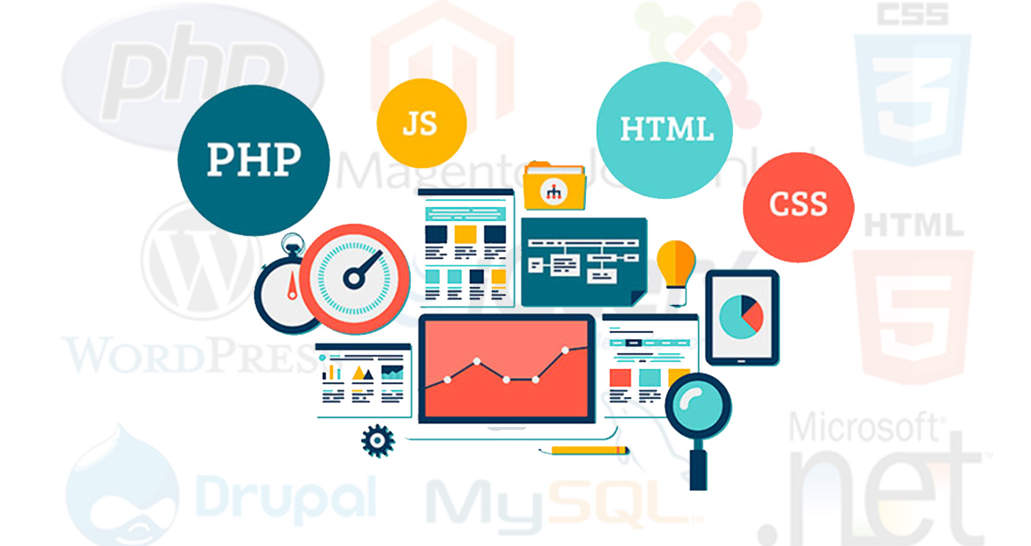
02. Dynamic Websites
Whilst still using HTML coding, a dynamic website pulls different content into a webpage from repository of database within the website (or other external sources)
This enables the website to present varying content in a page based on the visitor’s choices as well as past visit history using cookies and other variables.

Slide 18

Resume at 10.50am

Slide 19
Web How it Works
On the simplest level, the web physically consists of the following components
A digital device – a device which used to access the website
A web browser – A software installed on your device which helps you to browser the web

Slide 20
Web How it Works
An internet connection – This is provided by an ISP and connects you to the internet to reach to any website
A Web server – This is the computer on which a website is hosted
Routers and Switches – They are the combination of software and hardware who take your request and pass to appropriate web server

Slide 21
Client Server Architecture
Client Server architecture is a computing model in which multiple components work in strictly defined roles to communicate
The server hosts, delivers and manages most of the resources and services to be consumed by the client
This type of shared resources architecture has one or more client computers connected to a central server over a network or internet connection

Slide 22

Client Server Architecture
Request
Response

Slide 23
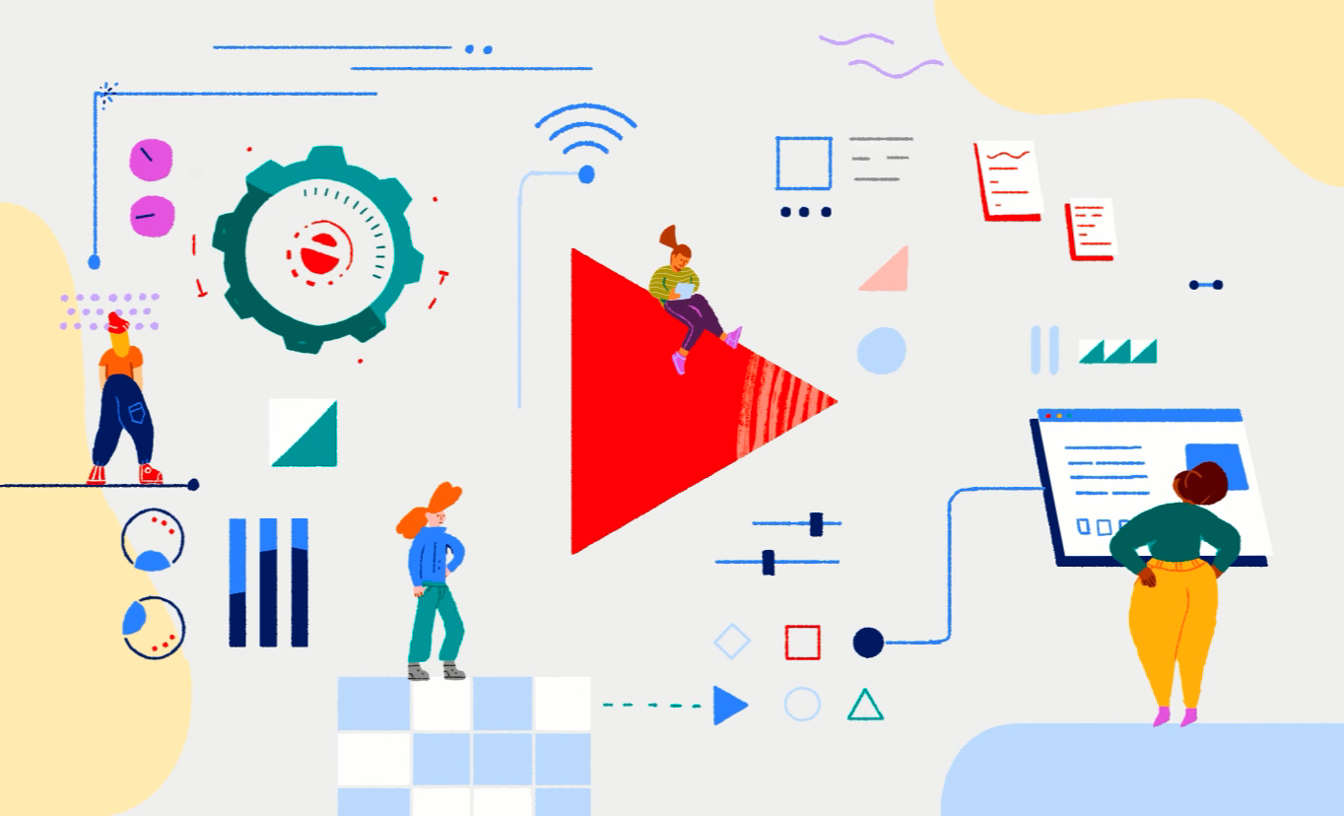
Ever wounder how YouTube works?

